Slide 1
What is Science Olympiad?

Slide 2
Science Olympiad competitions are like academic track meets, consisting of a series of 23 team events in each division.
The events vary from year to year, covering subjects such as:
-earth science
-chemistry
-anatomy
-physics
-genetics
-geology
-mechanical engineering
In our region there are a few other schools with Science Olympiad teams such as Troy, Aliso Niguel, and more.

Slide 4
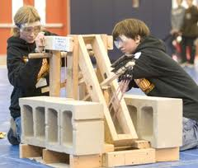
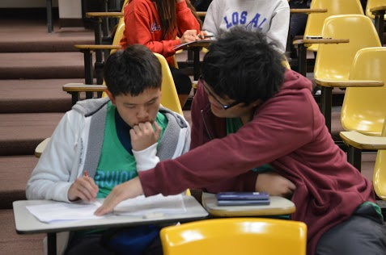
There are events with written tests, as well as hands on labs and experiments.
Usually two to three members are sent to each event, the ones who are strongest in that subject.

Slide 5
Being Part of the Team
Being on the team involves:
Weekly practices, most likely at lunch
Independent studying, which involves a time commitment of a few hours each week.
Saturday tournaments (just a few each year).
Helping out fundraisers in order to raise money (we have to pay for bus rides, materials, registration fees, and more).

Slide 6
Why Join?
For anyone that loves science and is considering a job in this field, Science Olympiad is a great extracurricular.
Colleges LOVE it because it shows commitment to your subject of choice.
All that hard work is worth it in the end.
It’s a great way to make new friends and have a good time.

Slide 7
Thanks for Coming!

