Slide 1


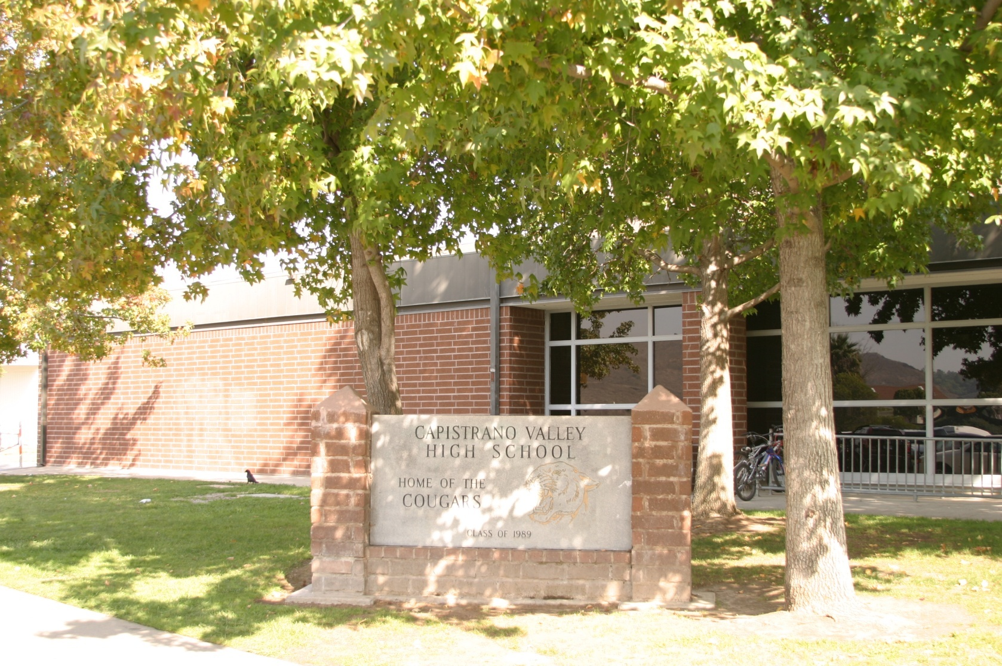
Capistrano Valley High School
IB Program Overview

Slide 2

“The IB builds on the most important knowledge, wisdom and ways of knowing from the past; engages seriously with the trends, promises and tribulations of the 21st century; and, most importantly, ponders how we might achieve the kind of world in which we would all like to live—sane, peaceful, sustainable… the IB asks, To what ends shall we put our knowledge?”
- Professor Howard Gardner, Harvard University

Slide 3
Why the Diploma?
Pre-university qualification
International education
International recognition
Breadth and Depth
Challenging Programs
Critical thinking, intercultural understanding
Lifelong learners

Slide 4
IB Programme History at CVHS
Started the IB Diploma programme in 2005
First Diploma graduates in May 2007
In the past 10 years 277 students have earned an IB Diploma
    Average points earned =31
    Average pass rate = 92%
    In approximately 60% of the subjects, our students have scored above the world wide average.

Slide 5
IB Programme at CVHS
In spring of the sophomore year students elect to enroll in IB programme
IB coordinators meet with each prospective student individually to create a 2 year IB plan
IB coordinators will continue to monitor student throughout the 2 years
Typically 30-36 students begin the programme
Normally about 30-32 will complete the programme
Students may opt to complete certificates in the subject areas instead of the full Diploma

Slide 6
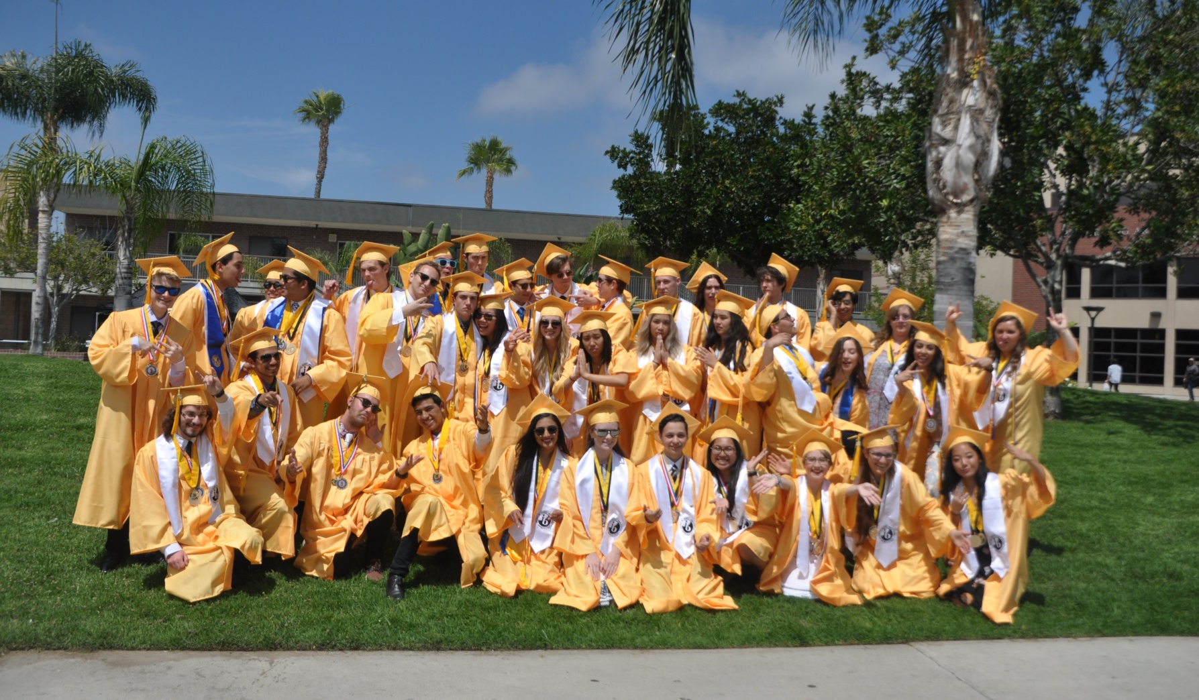
2016 Diploma Graduates

Slide 7
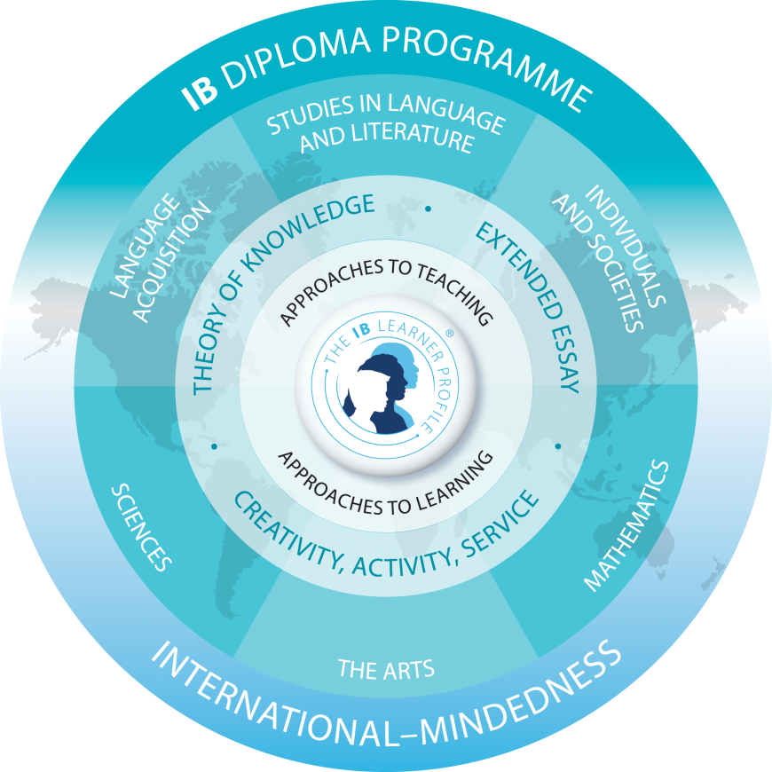
The Diploma
GROUP 1
LANGUAGE & LITERATURE
GROUP 2
GROUP 3
LANGUAGE
ACQUISITION
INDIVIDUALS
AND
SOCIETY
SCIENCES
GROUP 4
GROUP 5
MATHEMATICS
GROUP 6
ARTS

Slide 8
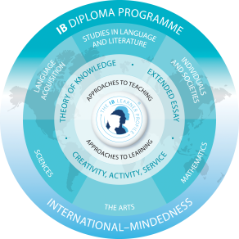
Diploma Requirements
One subject is studied from each area 1 -5.
Student chooses a sixth subject from either Group 6, or one of the other groups.
Three subjects are Higher level (2 -years) and three Standard level.
CAS, TOK and Extended Essay

Slide 9
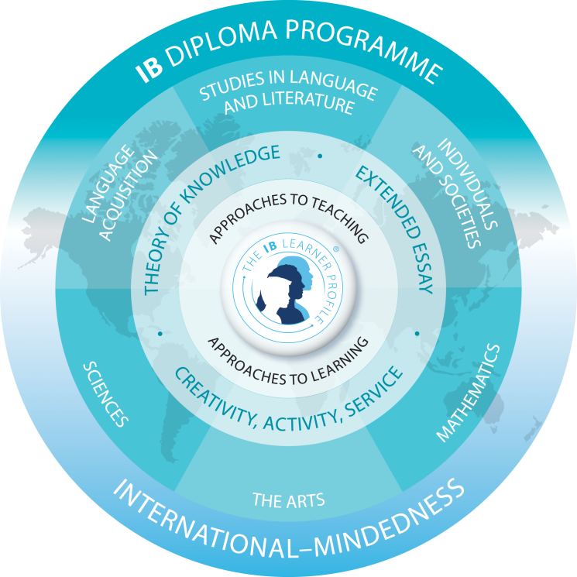
Freshman Courses
Note: All freshman must be in PE
GROUP 1
Honors English
ATMS Honors English
It is imperative that the study of a world language be started before sophomore year
GROUP 2
Spanish-I or II
French-I or II
German-I
GROUP 3*
World History
Hon World History
AP World History
GROUP 4
GROUP 5
Honors Biology
ATMS Hon Biology
Algebra I
Hon AlgII Trig
Hon ATMS AlgIITrig
Geometry
GROUP 6*
Elective

Slide 10
Sophomore Year
GROUP 1
English II Hon
English II Hon ATMS
GROUP 2
Spanish-II or III
French-II or III
German-II
GROUP 3
AP European
History
AP World History
GROUP 4
Honors Chemistry
Hon Chemistry ATMS
Physics
GROUP 5
Geometry
AlgIITrig
AP Stats
GROUP 6
Elective

Slide 11
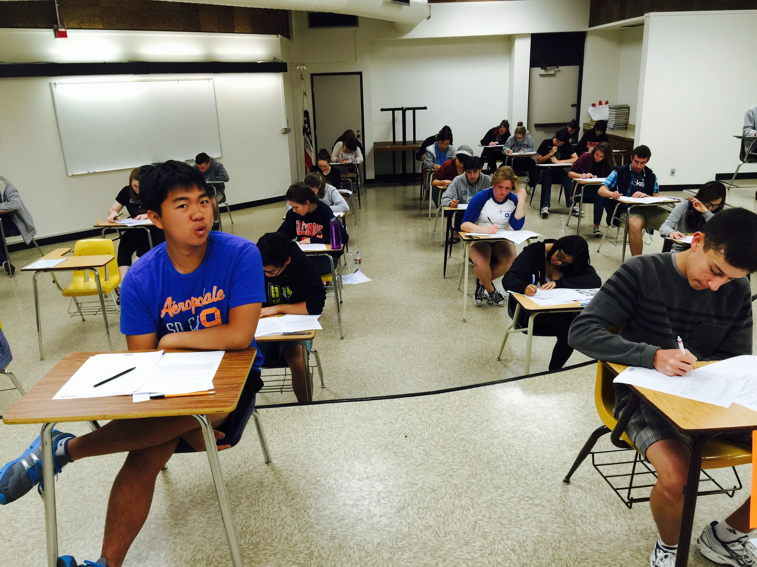
Junior / Senior Years
The Diploma Programme is a 2 year program that begins in the Junior Year
Students must take 6 exams (one per Group)
3 of the exams must be at the Higher Level (HL) and 3 at the Standard Level (SL)
Students may take 2 SL exams during their Junior year

Slide 12
Junior/Senior Years
Student Choice-Humanities
GROUP 1
English HL**
GROUP 2
GROUP 3
Spanish-SL/HL
French-SL/HL
German-SL/HL
History of the
Americas HL**
GROUP 6
Music SL/HL
Theatre SL/HL
Visual Arts SL/HL
Psychology SL
**All IB Students take this class in 11th & 12th grade

Slide 13
Junior/Senior Years
Student Choice-Math/Science
GROUP 4
Biology HL
Environmental Science SL
Chemistry SL
Physics SL / HL
GROUP 5
Mathematics HL
Mathematics SL
Math Studies SL
GROUP 6
Second Science
Computer Science

Slide 14
Theory of Knowledge
”What are the different ways of knowing?”
An interdisciplinary requirement intended to stimulate critical reflection on the knowledge and experience gained inside and outside the classroom.
It is a mandatory component of the Diploma.
Students write a conceptual essay for assessment externally.
With the Extended Essay it can contribute to up to 3 bonus points.

Slide 15
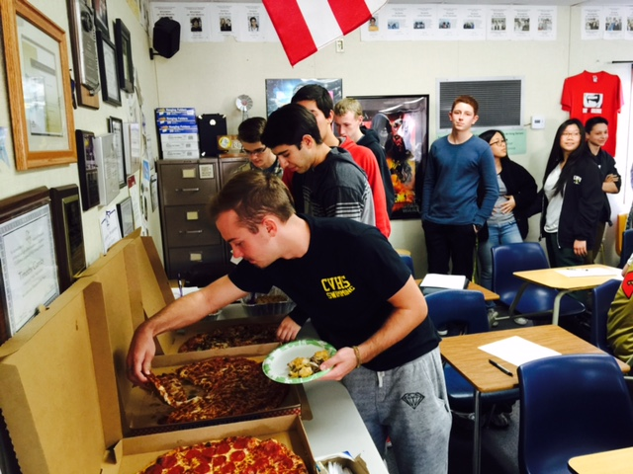
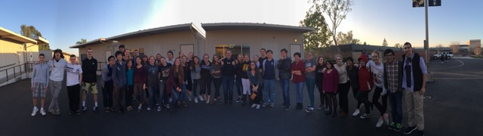
  Many students will say “TOK is the main reason to do the IB program!”
Socratic Seminar
Links all the Diploma subjects
Students collaborate on presentations in which they apply TOK to a real world situation
            ”
“What happens in TOK stays in TOK”

Slide 16
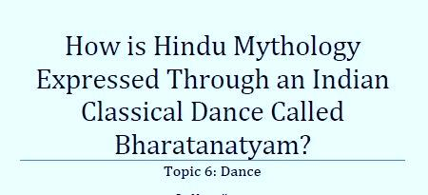
Extended Essay
A 4000 word study of a topic of special interest.
It acquaints students with the kind of independent research and writing skills expected by universities.
It may be written in one of 60 subjects, including languages.
The essay permits students to deepen their programmes of study, by selecting a topic in one of their HL courses or by writing in a subject not included in their programme choices.
It is a mandatory component of the Diploma
With TOK it can contribute to up to 3 bonus points.
Students have a mentor to advise them

Slide 17
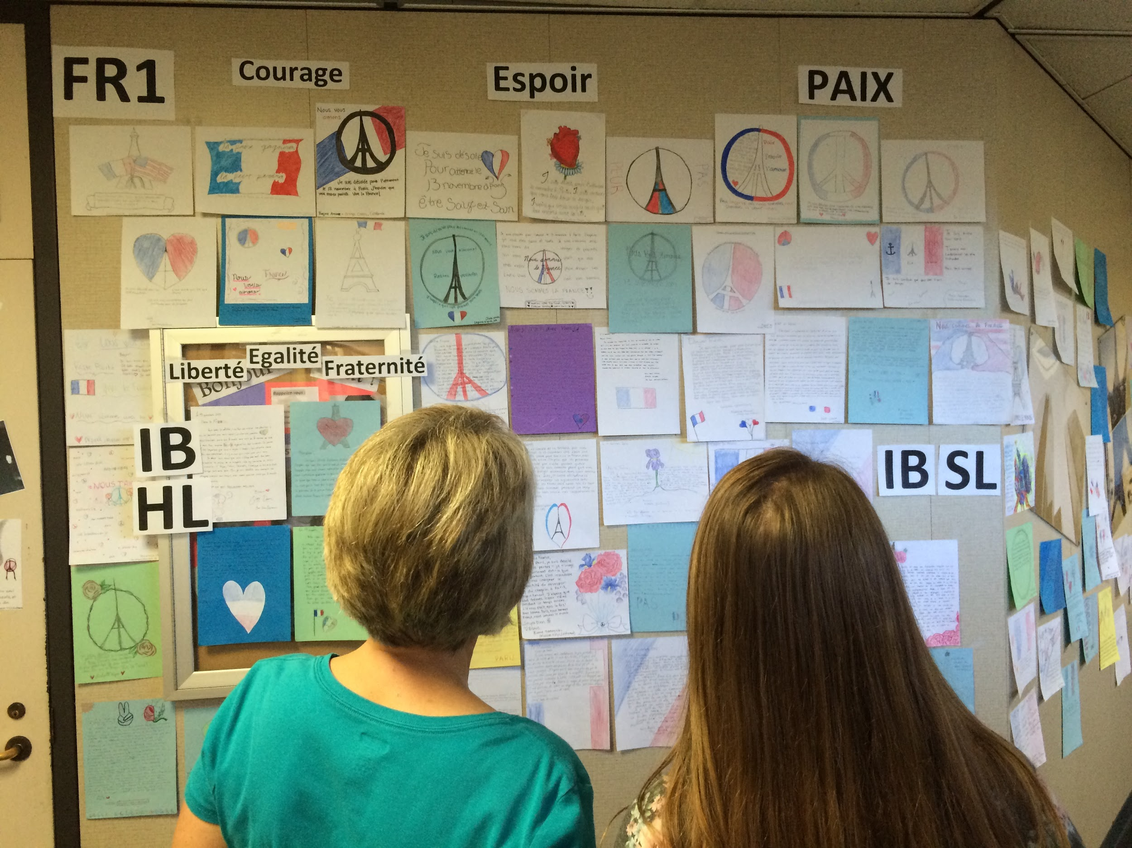
CAS (Creativity Action & Service)
The CAS programme encourages students to add balance to their schedules by participating in creative activities, volunteering and exercising:
  they may, for example, participate in theatre or musical productions, sports and community service activities.
Students should, through these activities, develop greater awareness of themselves, concern for others, and the ability to work cooperatively with other people.
Students will design and complete a CAS project
Students will reflect on the project
A requirement to achieve the Diploma

Slide 18
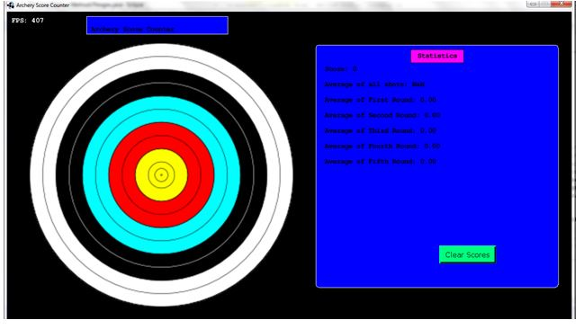
Subject Assessment
All subjects have an internally assessed, externally moderated component.
  as well as an exam taken in May
Each subject final result is reported as a criterion or standards referenced grade:
  Scale for IB is 1-7 (Note: AP scale is 1-5)
The maximum aggregate grade from subjects is 42 (i.e. 6 subjects X maximum grade of 7).
Three extra points may be awarded on the basis of performance in the Extended Essay and TOK
The minimum score is 24 points

Slide 19
Passing the Diploma
Students can fail to qualify for the Diploma- automatically defaults to certificate in each subject passed
All students must complete CAS, submit an extended essay and TOK essays to pass.
Poor Extended Essay’s or TOK essays = fail
24 is the minimum points required to pass.
  Average a 4 in the three Standard level subjects
  Average a 4 in the three Higher level subjects. Poor Extended essays and TOK = fail
The school will track student progress and advises students and parents if it believes that the student will have difficulty achieving the Diploma.

Slide 20
Recognition and Results
The I.B. Diploma is recognized by Universities nationally and internationally.
Many Universities give first year credit for Diploma subjects-similar to AP.

Slide 21
IB Diploma – College Acceptance Rates
School | All Applicants | IB Diploma Applicants
Brown University | 17% | 21.5%
College Of William & Mary | 37% | 66.4%
Columbia University | 12% | 18.5 %
Cornell University | 28.5% | 51%
Dartmouth College | 20.7% | 33.3%
Georgia Institute of Technology | 53.7% | 88%
Harvard University | 11% | 14.8%
Johns Hopkins University | 35% | 68.8%
MIT | 16.9% | 26.2%
Princeton | 11% | 13.8%
Stanford | 12.6% | 18.3%

Slide 22
IB Diploma – College Acceptance Rates
School | All Applicants | IB Diploma Applicants
Tufts | 26.6% | 52.6%
US Air Force Academy | 12.1% | 68.4%
US Naval Academy | 11.7% | 45%
UC Berkeley | 24% | 47.1%
UC LA | 24% | 47.1%
University of Chicago | 41.6% | 59.1%
University of Michigan | 49% | 72.7%
University of Pennsylvania | 21% | 24.7%
USC | 30.3% | 72.2%
Vanderbilt | 37.3% | 73.1%
Villanova | 14.5% | 89.5%

Slide 23
IB Diploma: a strong predictor for University Success

Slide 24
Traits of Successful IB Students
Self motivated and family supported
Desire to challenge themselves intellectually and academically
Good language skills
Critical thinkers
Time and stress management skills
Participate in school and community
Open to new ideas and tolerant of other’s ideas

Slide 25
Benefits of IB
Excellent “college prep” education!
  Breadth
  Depth
  Strong communication skills
  Aligns with Common Core State Standards
  It is applied learning across the disciplines
  May earn college credit
  Internationally recognized
IB emphasizes reflection, action taking, and international mindedness
IB instills resiliency and academic perseverance needed for career and college readiness

